Slide 1
SANDS - Sediment Analysis Network for Decision Support Danny Hardin, Marilyn Drewry, Tammy Smith, Matt He the University of Alabama in Huntsville Sandy Ebersole Geological Survey of Alabama
OS33G-08

Slide 2
Objectives
Help resolve the GOMA priority issues by providing sediment related decision support products to groups involved in coastal management, conservation, planning,
recovery, and mitigation
Provide end users the opportunity to better analyze, detect, and identify compositions and patterns of suspended sediment and sediment deposits.

Slide 3
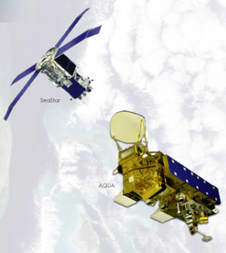
Influence of Sediment Disturbance
Since the year 2000, eastern Louisiana, coastal Mississippi, Alabama,
and the western Florida panhandle have been affected by 28 tropical storms, seven of which were hurricanes.
These tropical cyclones have significantly altered normal coastal processes and characteristics in the Gulf region through
sediment disturbance.
In fact, tropical storm-induced sediment disturbance is a
factor in four of the five Gulf of Mexico Alliance (GOMA) priority issues:
water quality for beaches and shellfish beds,
wetland and coastal conservation restoration,
characterization of Gulf habitats,
and reduction of nutrient inputs to coastal systems.

Slide 4
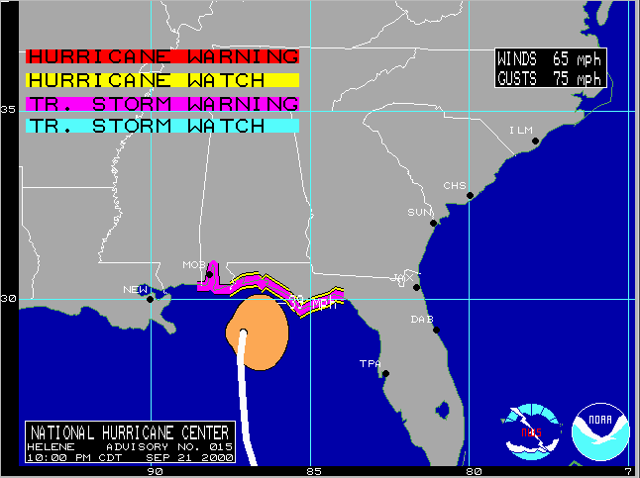
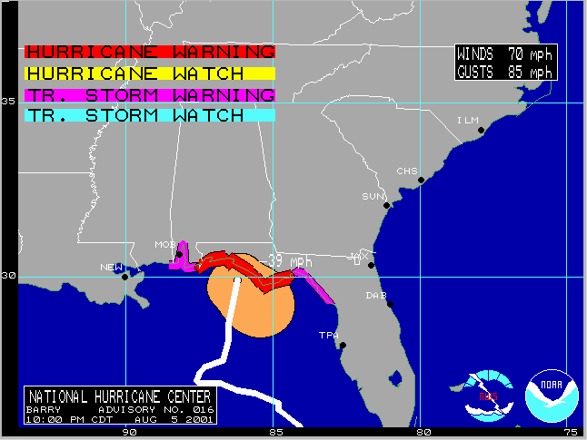
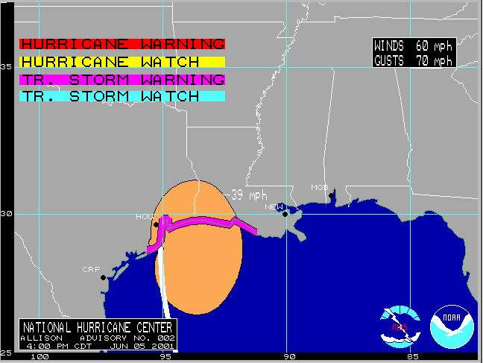
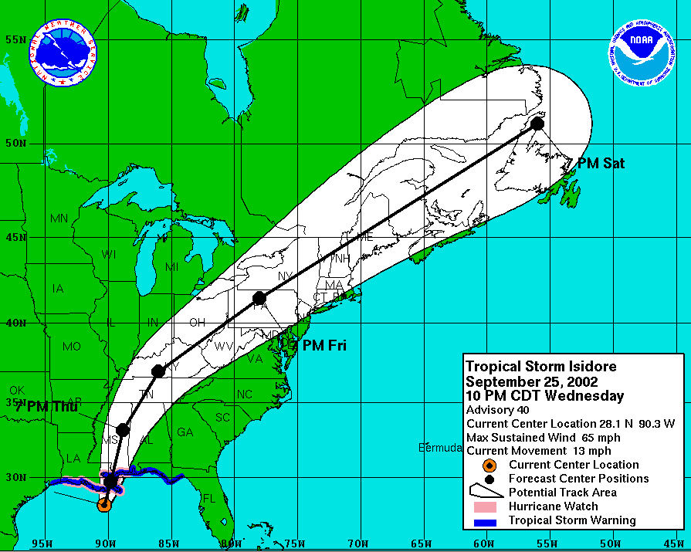
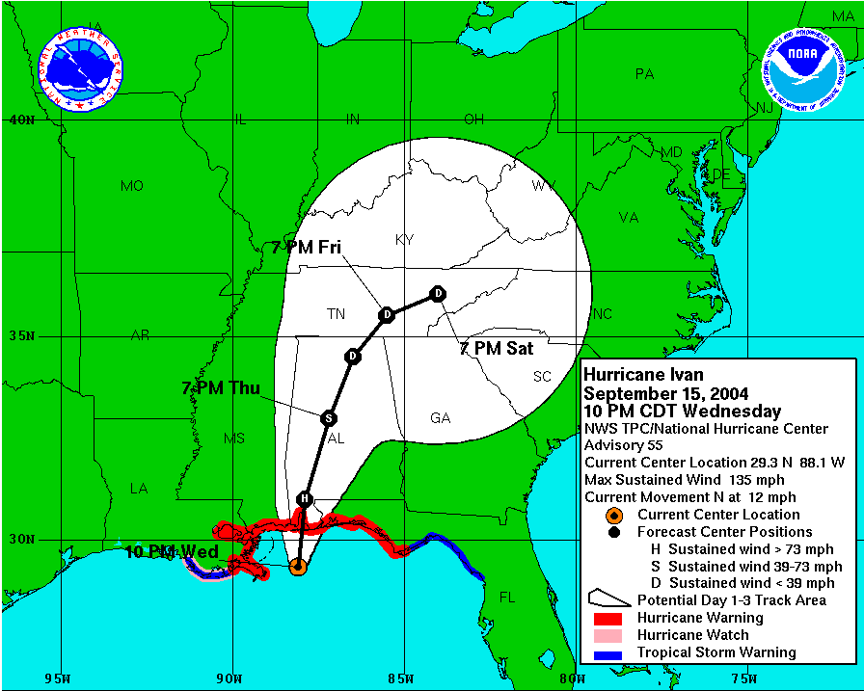
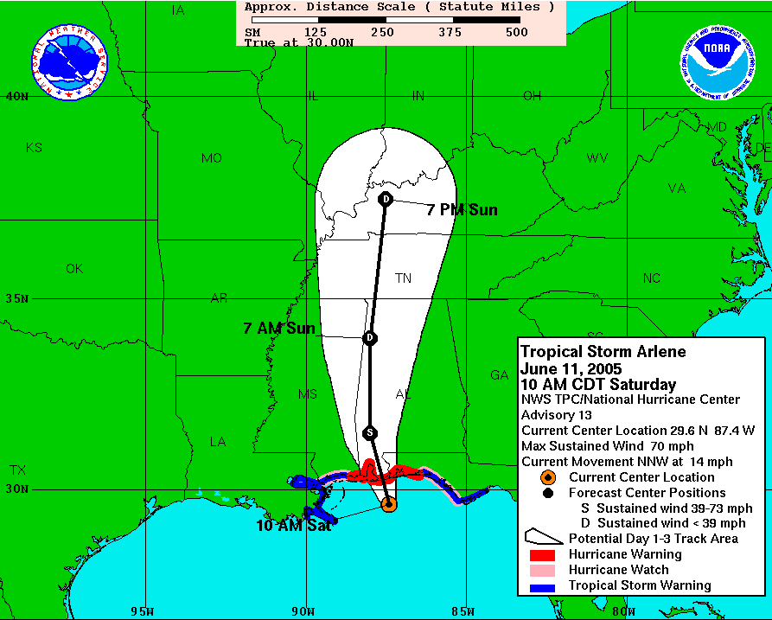
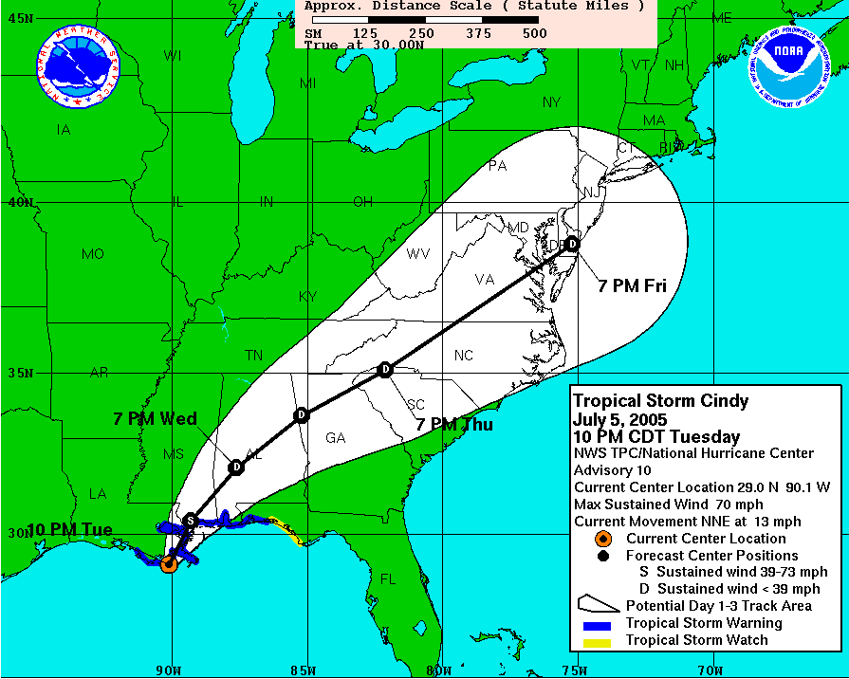
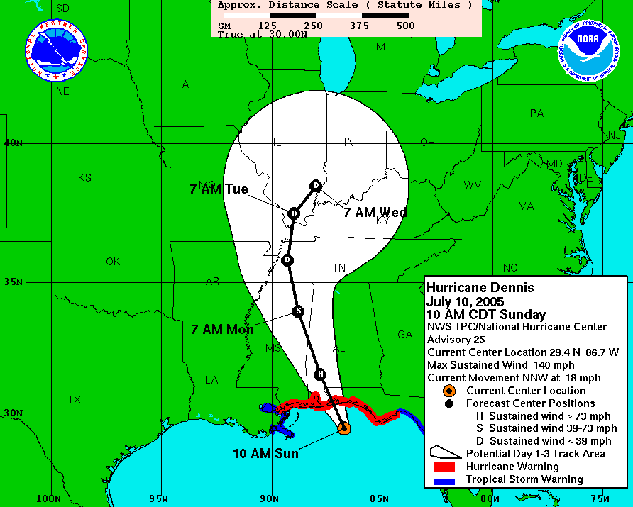
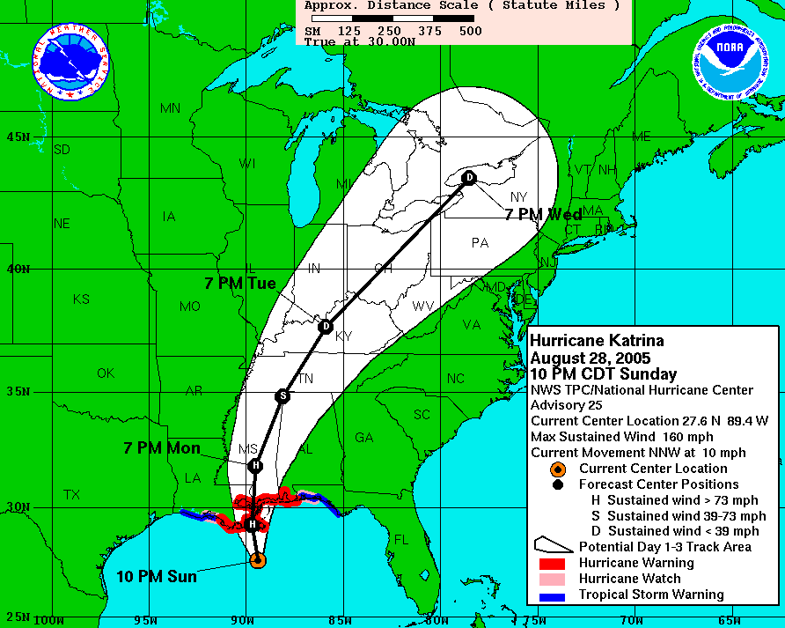
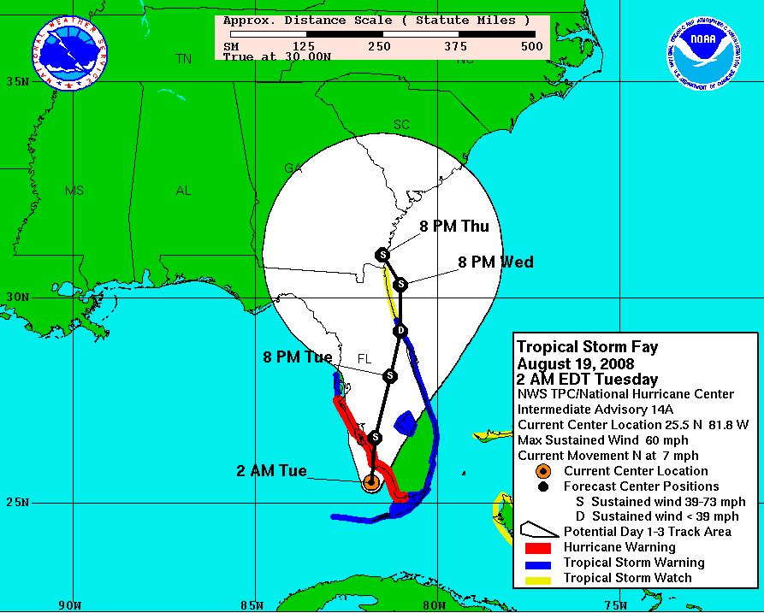
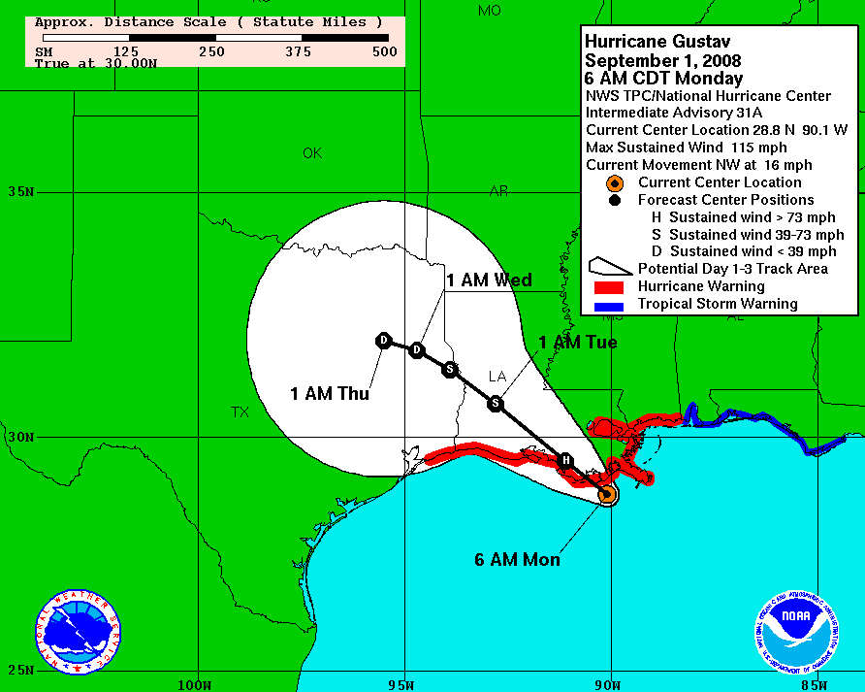
Helene 2000
Barry 2001
Allison 2001
SAND’S
Storms
Isidore 2002
Ivan 2004
Arlene 2005
Cindy 2005
Dennis 2005
Katrina 2005
Fay 2008
Gustav 2008

Slide 5
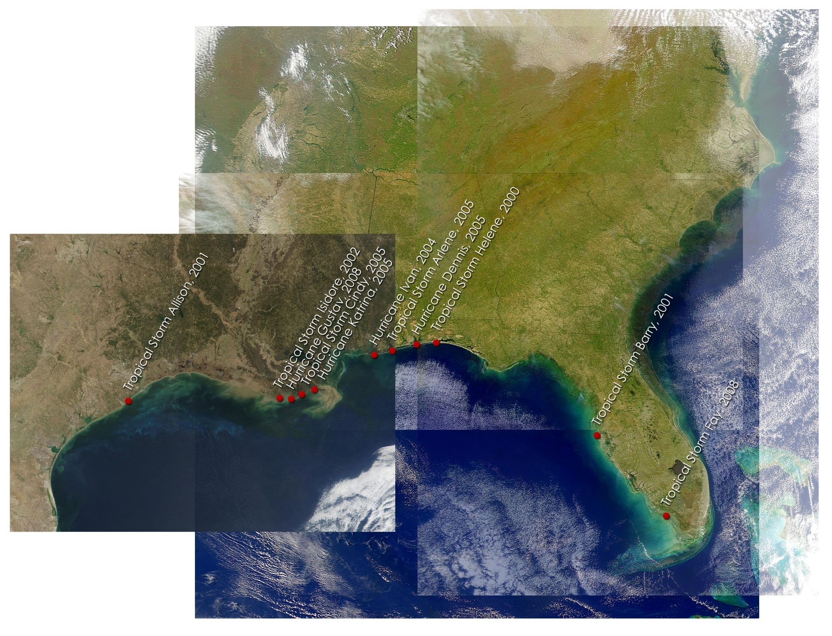
Landfall Locations for Storms in
SANDS Study Area

Slide 6
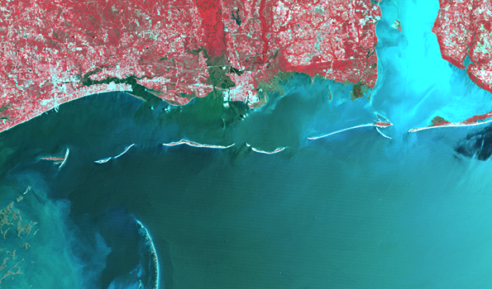
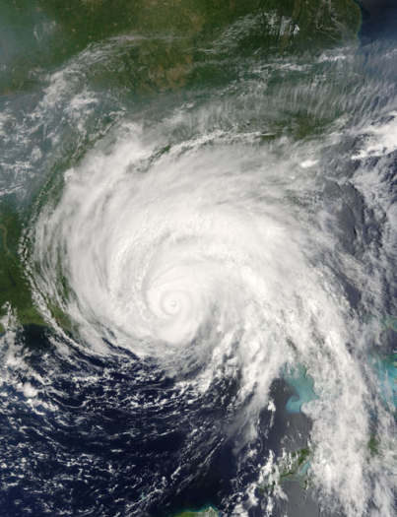
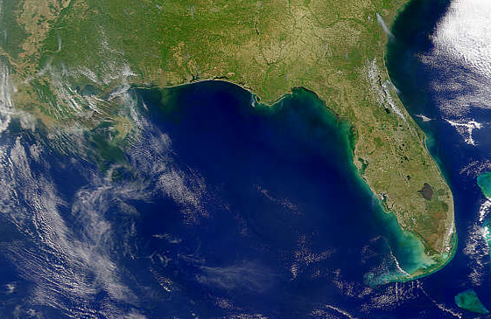
SANDS Source Data
Landsat 7 ETM+ all bands for 2000 through 2002
Landsat 5 TM all bands for 2003 through 2008
MODIS Aqua surface reflectance bands 8 through 16
SeaWiFS data, all bands, covering the region
SRTM elevation data
NDVI and EVI vegetation indices derived from MODIS

Slide 7
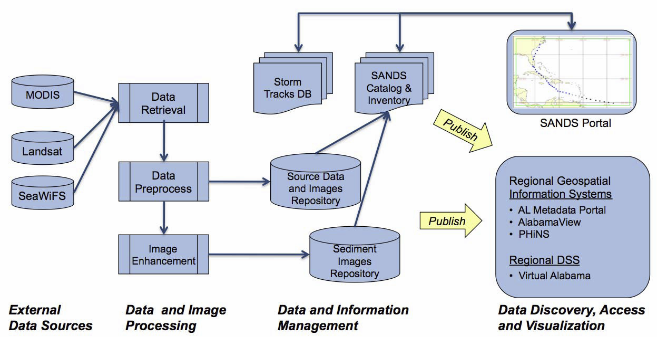
System Architecture
Regional Geospatial Information Systems
SANDS Data Portal
Alabama View
GHRC
PHINS
Regional DSS
Virtual Alabama

Slide 8
Product Generation Methodology
Traditional
enhancements
applied
Original Landsat
bands downloaded
from ITSC ftp site
All
bands combined
to make a
stacked image
Clouds and
land removed
Results
combined
and edited
Supervised
classification
Final image
showing enhanced
suspended
sediment
FGDC metadata
produced for
final image
Final image, metadata, and original
stacked image uploaded to
ITSC ftp site

Slide 9
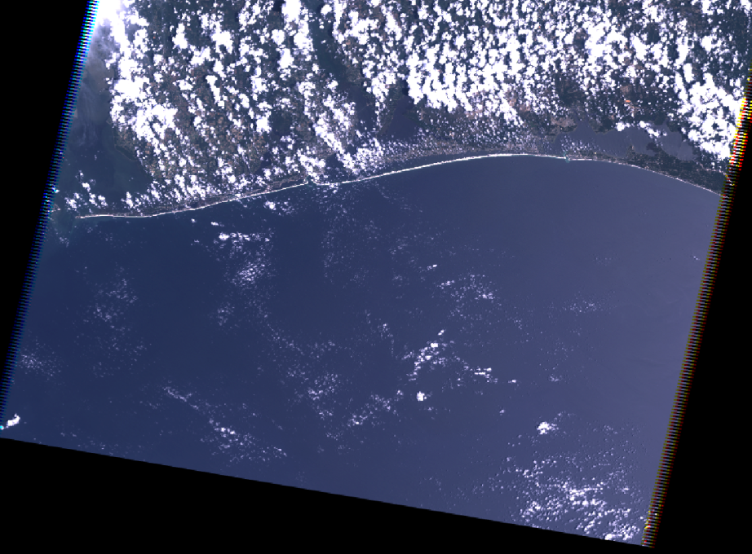
Product Generation Methodology
Traditional
enhancements
applied
Original Landsat
bands downloaded
from ITSC ftp site
All
bands combined
to make a
stacked image
Clouds and
land removed
Results
combined
and edited
Supervised
classification
Final image
showing enhanced
suspended
sediment
FGDC metadata
produced for
final image
Final image, metadata, and original
stacked image uploaded to
ITSC ftp site

Slide 10
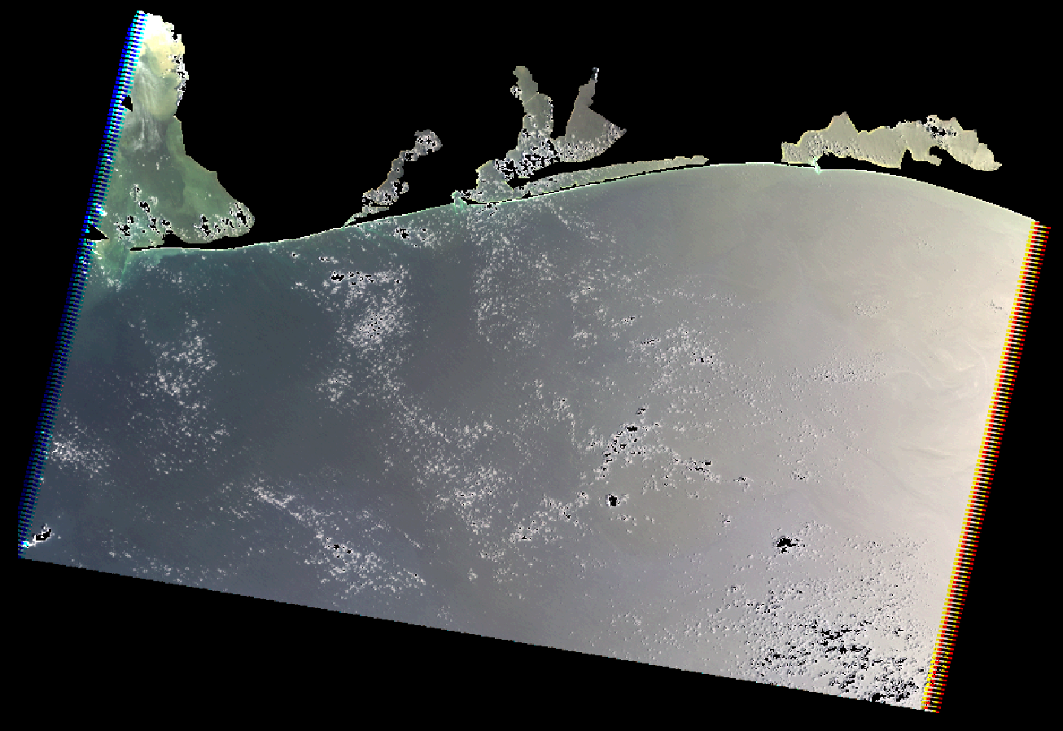
Product Generation Methodology
Traditional
enhancements
applied
Original Landsat
bands downloaded
from ITSC ftp site
All
bands combined
to make a
stacked image
Clouds and
land removed
Results
combined
and edited
Supervised
classification
Final image
showing enhanced
suspended
sediment
FGDC metadata
produced for
final image
Final image, metadata, and original
stacked image uploaded to
ITSC ftp site

Slide 11
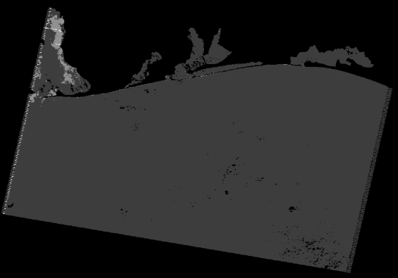
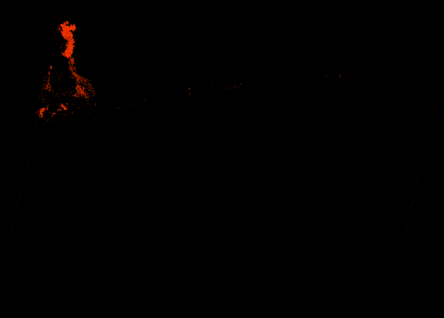
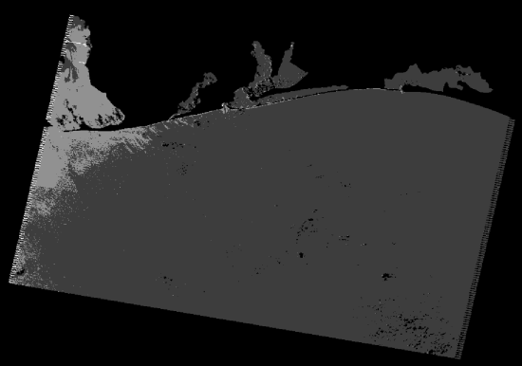
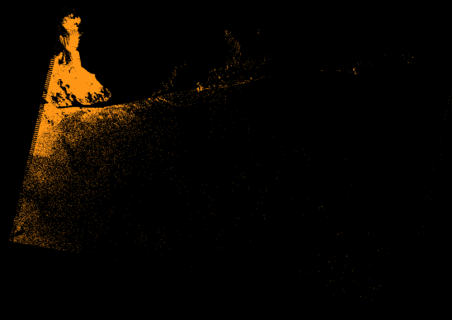
Product Generation Methodology
Traditional
enhancements
applied
Original Landsat
bands downloaded
from ITSC ftp site
All
bands combined
to make a
stacked image
Clouds and
land removed
Results
combined
and edited
Supervised
classification
Final image
showing enhanced
suspended
sediment
FGDC metadata
produced for
final image
Final image, metadata, and original
stacked image uploaded to
ITSC ftp site

Slide 12
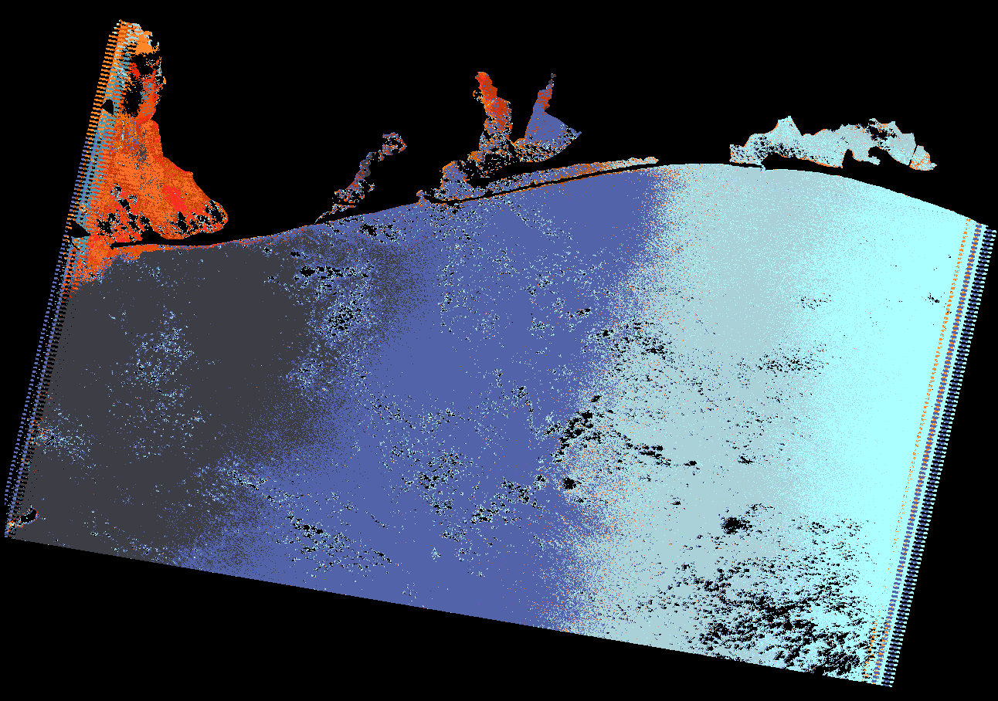
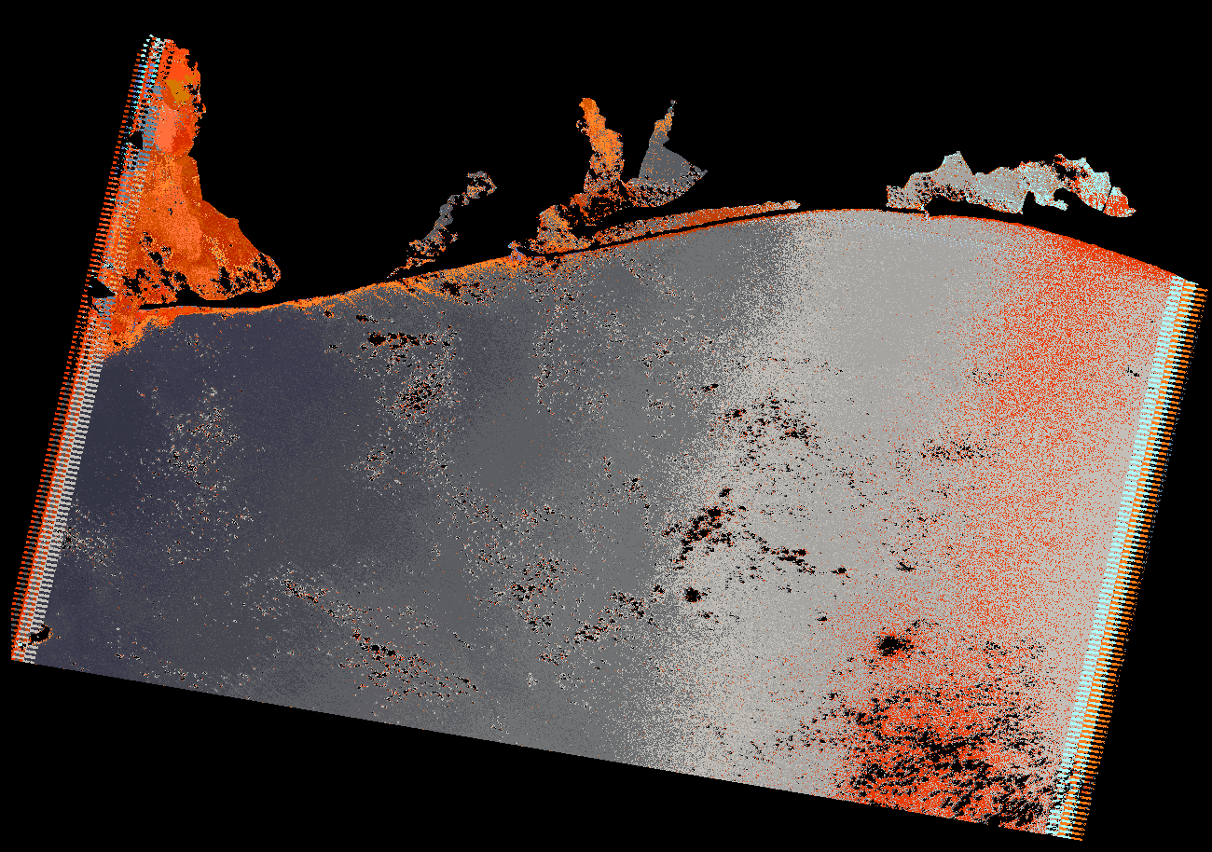
Product Generation Methodology
Traditional
enhancements
applied
Original Landsat
bands downloaded
from ITSC ftp site
All
bands combined
to make a
stacked image
Clouds and
land removed
Results
combined
and edited
Supervised
classification
Final image
showing enhanced
suspended
sediment
FGDC metadata
produced for
final image
Final image, metadata, and original
stacked image uploaded to
ITSC ftp site

Slide 13
Product Generation Methodology
Traditional
enhancements
applied
Original Landsat
bands downloaded
from ITSC ftp site
All
bands combined
to make a
stacked image
Clouds and
land removed
Results
combined
and edited
Supervised
classification
Final image
showing enhanced
suspended
sediment
FGDC metadata
produced for
final image
Final image, metadata, and original
stacked image uploaded to
ITSC ftp site

Slide 14
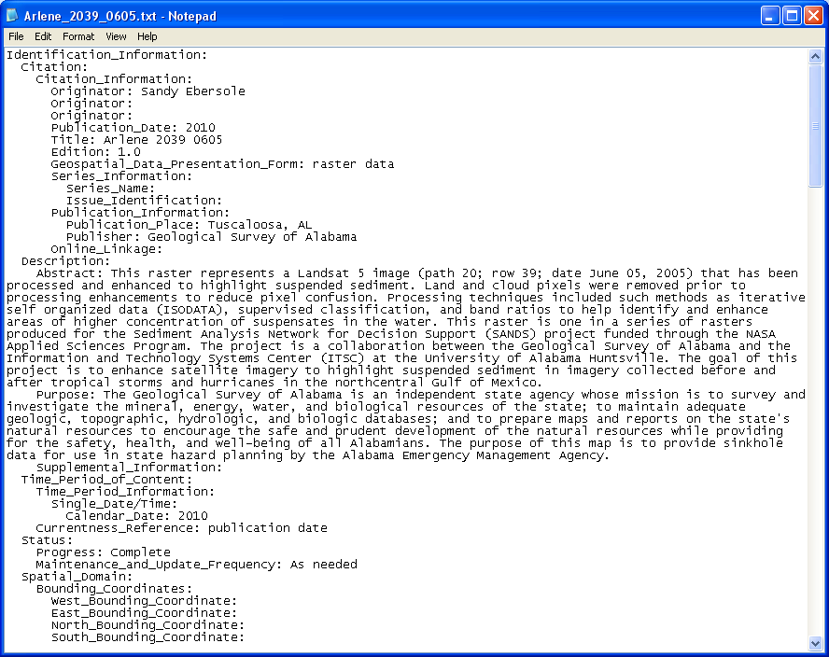
Product Generation Methodology
Traditional
enhancements
applied
Original Landsat
bands downloaded
from ITSC ftp site
All
bands combined
to make a
stacked image
Clouds and
land removed
Results
combined
and edited
Supervised
classification
Final image
showing enhanced
suspended
sediment
FGDC metadata
produced for
final image
Final image, metadata, and original
stacked image uploaded to
ITSC ftp site

Slide 15
Visual inspection and documentation of features discovered in enhancement and processing of imagery
Southeasterly pointing wisps of suspended sediment showing normal (pre-Arlene) sediment transport patterns. These wisps correlate with sand ridges on the seafloor.
Oil sheen off shore of Louisiana two days after Katrina. This oil was washed out from the oil spills onland. Patterns of the sheen help indicate flow and transport direction.

Slide 16
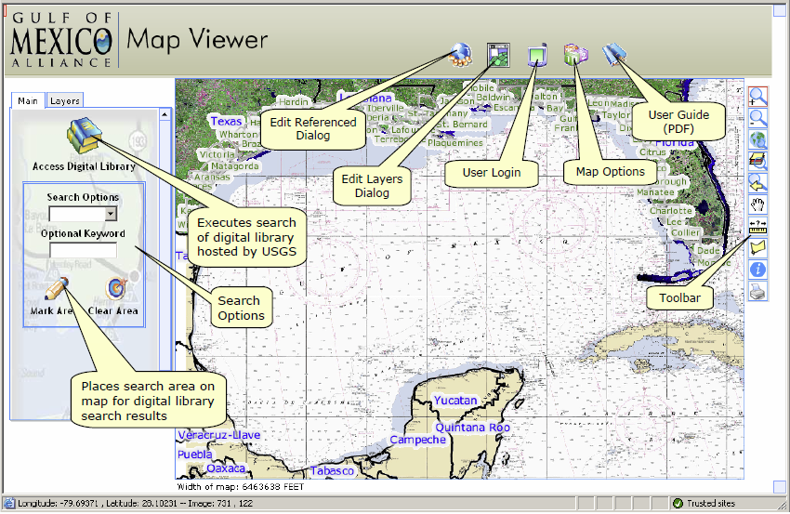
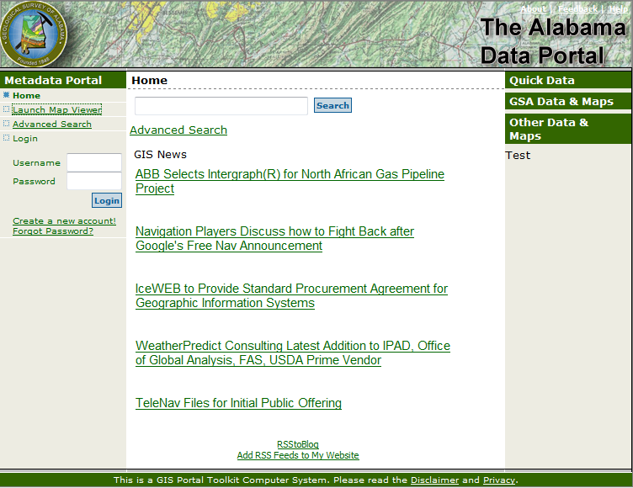
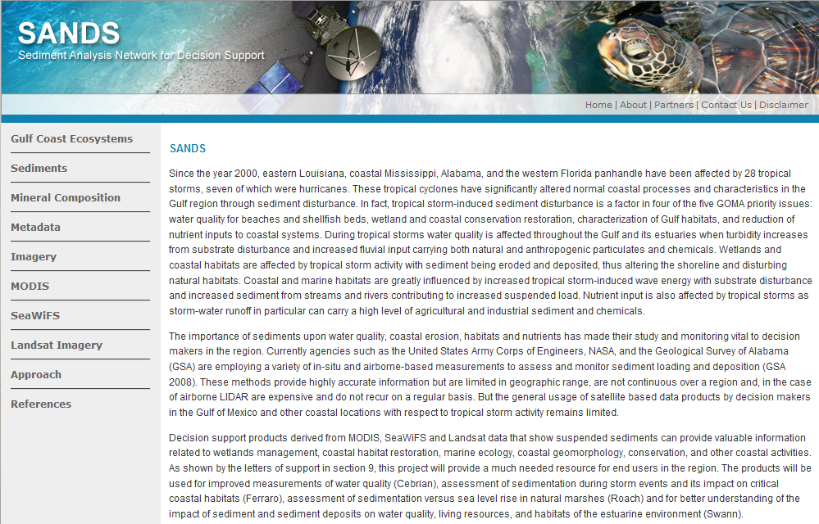
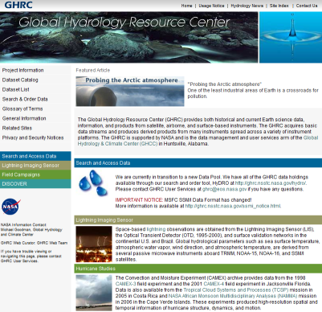
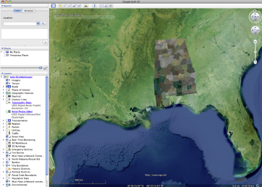
Data Product Distribution
http://www.alabamaview.org
http://phins.sam.usace.army.mil/
http://sands.itsc.uah.edu/
http://portal.gsa.state.al.us/
http://ghrc.nsstc.nasa.gov/
http://www.alabamaview.org/

Slide 17
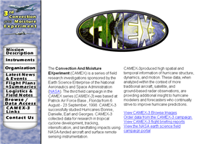
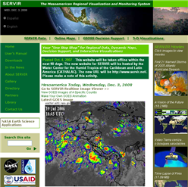
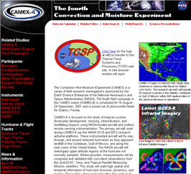
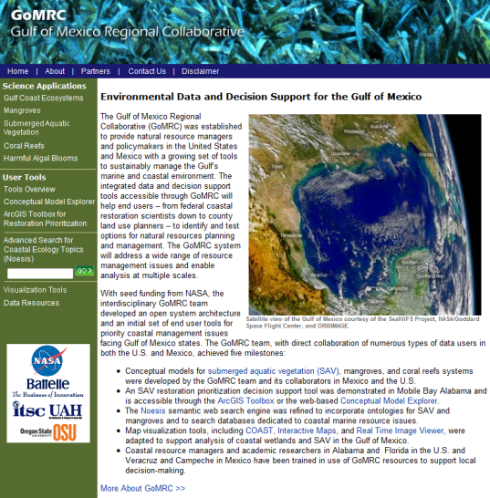
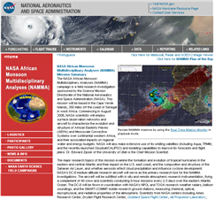
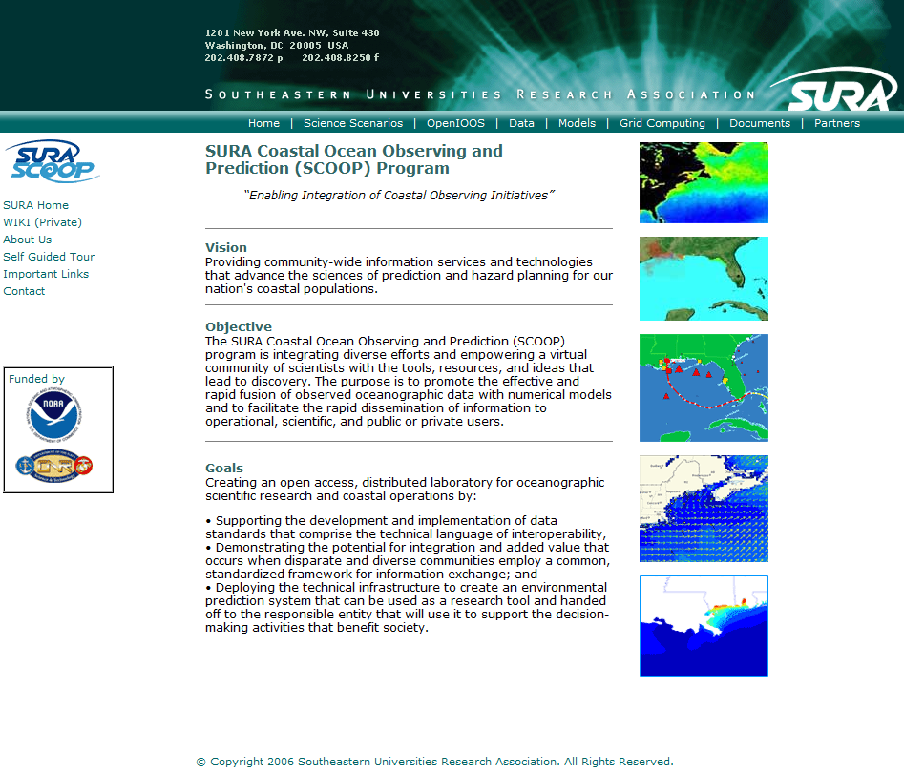
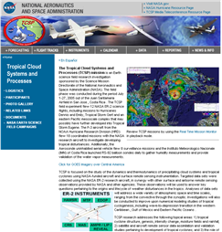
Related Coastal Projects
SERVIR
GoMRC
SCOOP
NASA Tropical Storm
Field Campaigns

Slide 18
Backup Charts

Slide 19
Step 1: Stacking bands for a given Landsat scene (path, row, day)
Landsat Band 1
Landsat Band 2
Bands
1, 2, 3,
4, 5, and 7
are stacked
Stacked 7-band
Landsat scene
Landsat Band 3
Landsat Band 4
Landsat Band 5
Landsat Band 7
Step 2: Deleting land and clouds to reduce pixel confusion
Stacked
Landsat
scene
Land
pixels deleted
with polygon
mask
Stacked Landsat
scene
minus land
Identification
and deletion
of cloud pixels
via
unsupervised
classification
Stacked Landsat
scene minus
land and
minus clouds
(cloudless water)

Slide 20
Step 3: Running and comparing enhancement techniques
Stacked 7-band
cloudless water
pixels
Band ratio
B3/B1
Output grid of
B3/B1
Good output.
Save
Output grid of
B3/B1
Stacked 7-band
cloudless water
pixels
Band ratio
B2/B1
Output grid of
B2/B1
Visual
comparison of
enhancement
techniques
Good output.
Save
Output grid of
B2/B1
Stacked 7-band
cloudless water
pixels
Clay
enhancement
Output grid of
clay
enhancement
Good output.
save
clay
enhancement
grid
Stacked 7-band
cloudless water
pixels
Iron oxide
enhancement
Output grid of
Iron oxide
enhancement

Slide 21
Step 4: Extraction of suspended sediment from enhancements
Output grid of
B3/B1
Extraction of
suspended
sediment
pixels based
on high pixel
values
Grid of pixels
representing varying
intensities of
suspended sediment
for B3/B1
Output grid of
B2/B1
Extraction of
suspended
sediment
pixels based
on high pixel
values
Grid of pixels
representing varying
intensities of
suspended sediment
for B2/B1
Suspended
sediment pixels
mosaicked
Grid of combined
suspended
sediment from
enhancements
Output grid of
clay
enhancement
Extraction of
suspended
sediment
pixels based
on high pixel
values
Grid of pixels
representing varying
intensities of
suspended sediment
for clay
enhancement

Slide 22
Step 5: Supervised classification (performed twice – once for the western side and once for the eastern side of the image due to pixel confusion from sunglint)
Stacked 7-band
cloudless water
pixels
Supervised
classification of
western side
of image
Supervised grid with
classes representing
suspended sediment,
clear water, and
cloud fringes
Extraction of
suspended
sediment
pixels in western
side of image
Grid of pixels
representing varying
intensities of
suspended sediment
in western part of
image
Stacked 7-band
cloudless water
pixels
Supervised
classification of
eastern side
of image
Supervised grid with
classes representing
suspended sediment,
clear water, and
cloud fringes
Extraction of
suspended
sediment
pixels in eastern
side of image
Grid of pixels
representing varying
intensities of
suspended sediment
in eastern part
of image

Slide 23
Step 6: Final products (metadata was also written to accompany the final image)
Grid of combined
suspended
sediment from
enhancements
Grid of pixels
representing varying
intensities of
suspended sediment
in western part of
image
Suspended
sediment pixels
mosaicked
Grid of combined
suspended
sediment pixels
Clean-up of
error pixels
(mainly cloud
pixels and
image edges)
Final image of the
Landsat scene
enhanced to show
suspended sediment
Grid of pixels
representing varying
intensities of
suspended sediment
in eastern part
of image

